Slide 1

Managing Routers

Slide 2
Managing Routers
Bla

Slide 3
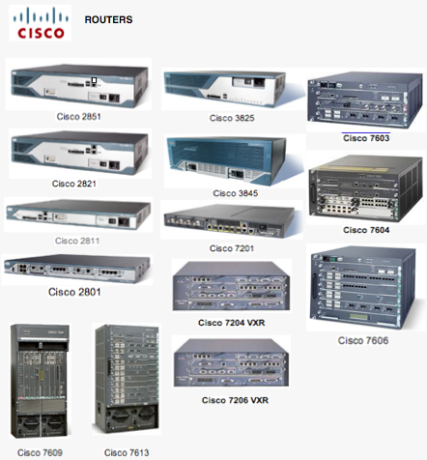
Routers

Slide 4
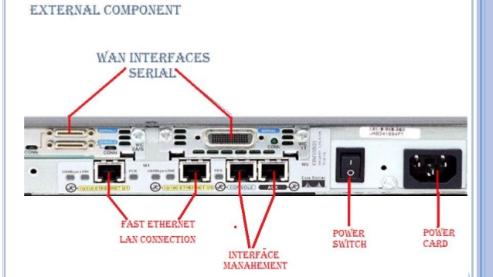
External Components of a Router

Slide 5
Internal Components of a Router
RAM
NVRAM
Flash
ROM
Console
Interfaces
Auxiliary

Slide 6
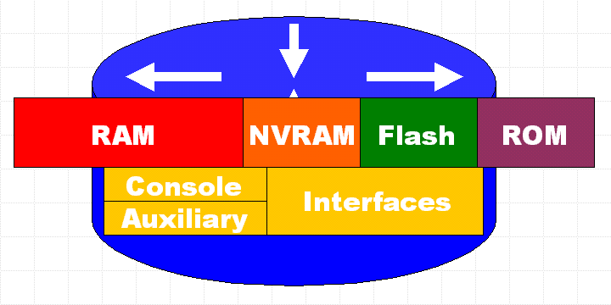
RAM
Temporary storage for router configuration files
RAM content is lost on power down or restart
Stores...
  Routing tables
  ARP cache
  Packet buffering

Slide 7
NVRAM
Non-volatile RAM
Stores backup/startup configuration files
Content is not lost when router is powered down or restarted.
C

Slide 8
Flash
EEPROM (Electronically Erasable Programmable Read-Only Memory)
Holds the Cisco IOS
(Internetworking Operating System)
Allows updating of software without replacing the Flash chip
Multiple versions of IOS can be stored
Retained on power down

Slide 9
ROM
Contains POST (Power On Self Test)
  check the basic functionality of the router hardware
  determines which interfaces are present
A bootstrap program
  Used to bring a router up during initialization
  It will boot the router and then load the IOS

Slide 10
ROM
And mini-operating system software:
  Backup, trimmed down version of the IOS
  Called the RXBOOT or bootloader by Cisco
  Can be used to bring up an interface and load a Cisco IOS into flash memory.
  The mini-IOS can also perform a few other maintenance operations, but not many.

Slide 11
Interfaces
Network connections through which packets enter and exit the router
Attached to the motherboard or as separate modules on “modular” routers.

Slide 12
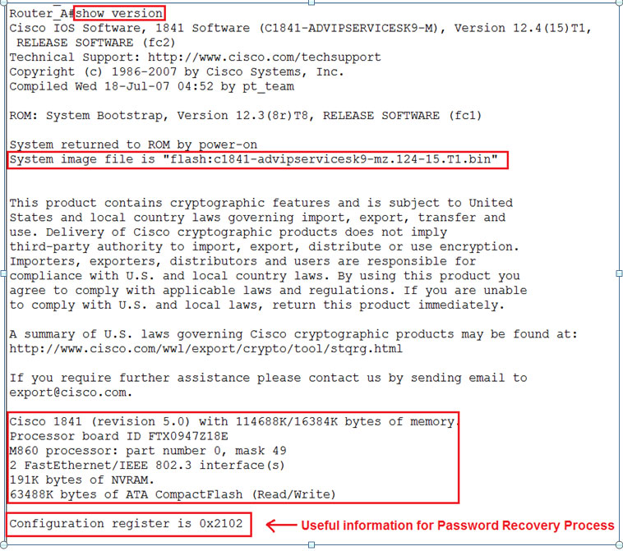
Configuration Register
Used to control how the router boots up.
Shown in the last line of the “show version command” output
Default is set to 0x2102
  which tells the router to load the IOS from flash memory as well as to load the configuration from NVRAM.

Slide 13
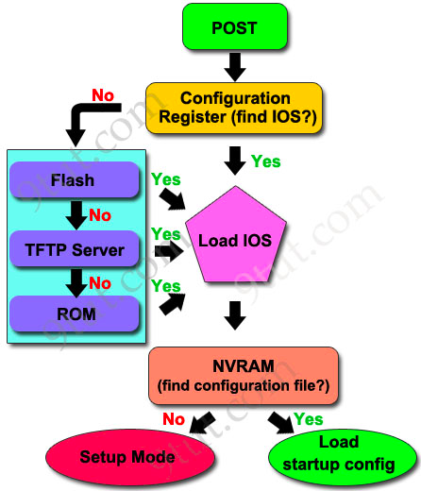
BOOT Sequence
1: Router performs a POST
2: Bootstrap looks for & loads the Cisco
IOS
3: IOS software looks for a valid
configuration file
4: Startup-config file (from NVRAM) is
loaded
  If startup-config file is not found, the router will start the setup mode

Slide 14
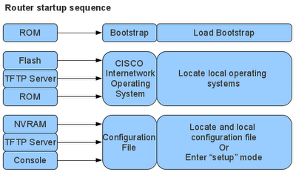
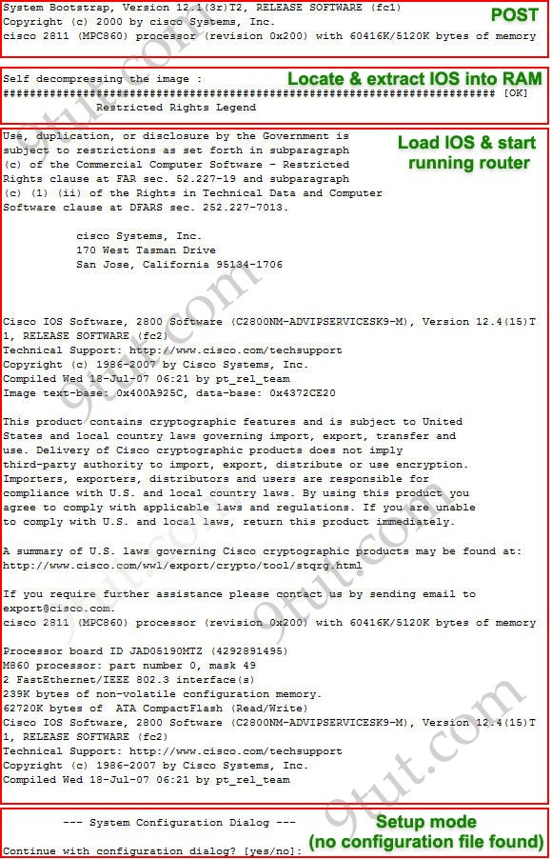
Router Boot Sequence

Slide 15
Router#show interfaces
Router#show version
Router#show flash
RAM
NVRAM
Flash
Internetwork Operating System
Backup
Configuration
File
Operating
Systems
Interfaces
Programs
Active
Configuration
File
Tables
and
Buffers
Router#show ip route
Router#show buffers
Router#show processes CPU
Router#show protocols
Router#show running-config
Router#show startup-config

Slide 16
Configuration Register
Register
  16-bit software written into NVRAM
  Loads from flash memory & looks for the startup-config file
Configuration Register Bits
  16 bits read 15-0, from left to right
  default setting: 0x2102
Register 2 1 0 2
Bit number 15 14 13 12 11 10 9 8 7 6 5 4 3 2 1 0
Binary 0 0 1 0 0 0 0 1 0 0 0 0 0 0 1 0
NOTE: 0x means the digits that follow are in hexadecimal

Slide 17
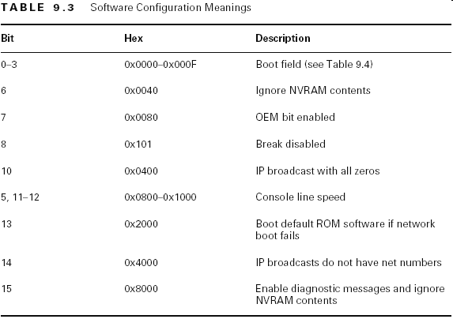

Configuration Meanings

Slide 18
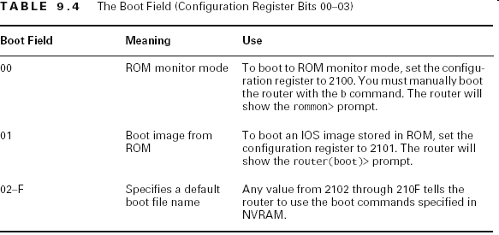
Boot Field Meanings
The boot field, which consists of bits 0–3 in the configuration register (the last four bits), controls the router boot sequence and locates the Cisco IOS.

